Slide 1

Spark Introduction

Slide 2

Objectives
By the end of this module, you will be able to:
Understand big data analytics & its applications
Understand Apache spark and its features
Explore spark architecture
Spark Components & advantages of spark

Slide 3

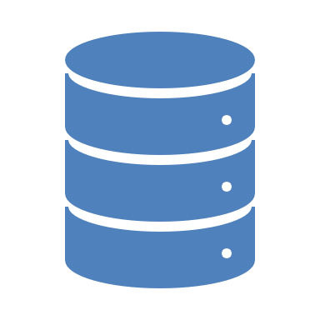
How to achieve real time processing?
Real time processing of big data has become one of the crucial need of industries from all domains.
From fraud detection in banking to live surveillance systems in government, automated machines in healthcare to live prediction systems in the stock market, everything around us revolves around processing big data in near real time.
Hadoop is an indeed an effective tool for batch data processing but is not designed for real time processing.

Slide 4
How software take decisions?
Apache spark is the industry standard framework designed for real time processing of big data.
Spark can be used to perform batch processing 100 times faster than that of Hadoop MapReduce (Processing framework in Apache Hadoop). Therefore, Apache Spark is the go-to tool for big data processing in the industry.

Slide 5

01
What is big data?
Types of big data
Big data sources
BIG DATA
02
Spark Introduction
Features of spark
Spark Cluster manager
SPARK
Agenda
03
SPARK
Components of spark
Advantages of spark
04
PYSPARK
Installing pyspark
Pyspark session
05
CONCLUSION
Group Activity
Summary

Slide 6


01
BIG DATA
What is big data?
Types of big data
Big data sources

Slide 7
Big data is the term for a collection of data sets so large and complex that it becomes difficult to process using on-hand database management tools or traditional data processing applications.
The challenges include capture, curation, storage, search, sharing, transfer, analysis, and visualization.
What is
Big Data?

Slide 8


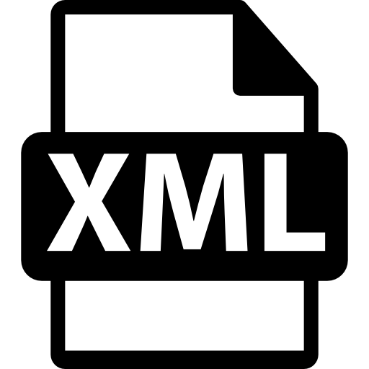
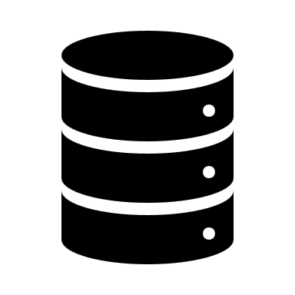





Types of Big Data
Unstructured
Structured
Semi-structured
Clouding
Analog data
XML
Data bases
GPS
Email
Enterprise systems
Video/audio streams
EDI
Any data that can be processed, accessed and stored as a fixed-format is named structured data.
Unstructured data refers to the data that lacks any specific form or structure whatsoever. This makes it very difficult and time-consuming to process and analyze unstructured data.
Semi-structured data is not bound by any rigid schema for data storage and handling. The data is not in the relational format and is not neatly organized into rows and columns like that in a spreadsheet.

Slide 9

How Big is Big Data?
Twitter users send out 285,000
Tweets
06
01
Google processes more than 2 MILLION Search queries
Facebook processes almost 350GB
of data
02
More than 100 MILLION New emails are generated
05
data Individuals and organizations launch 576 New websites
72 HOURS of new video are uploaded to you tube
04
03

Slide 10





Big data sources
Media
Web
Social influencers
Big data sources
Cloud
Social network profiles
Internet of things

Slide 11
02
SPARK
Spark Introduction
Features of spark
Spark Cluster manager

Slide 12
Apache Spark
Apache Spark is an open-source cluster computing framework for real-time processing.
Apache Spark is a unified analytics engine for big data processing, with built-in modules for streaming, SQL, machine learning, and graph processing.

Slide 13
Features of spark
Polyglot
Spark is written in scala, but the high level API in available in Java, Scala, Python and R. In python the distribution of spark is available as PySpark.
Speed
The PySpark framework is way faster than other traditional frameworks for Big Data processing.
Multiple Formats
Spark supports multiple data sources such as Parquet, JSON, Hive and Cassandra apart from the usual formats such as text files, CSV and RDBMS tables.
Real Time Computation
Because of the in-memory processing in the PySpark framework, it shows low latency.

Slide 14
Features of spark
Caching
Simple programming layer provides powerful caching and disk persistence capabilities.
Deployment
It can be deployed through Mesos, Hadoop via YARN, or Spark’s own cluster manager.
Hadoop Integration
Apache spark has compatibility with hadoop

Slide 15
Who uses spark?
Yahoo
Yahoo uses Apache Spark for its Machine Learning capabilities to personalize its news, web pages and also for target advertising. They use Spark with python to find out what kind of news – users are interested to read and categorizing the news stories to find out what kind of users would be interested in reading each category of news.
TripAdvisor
TripAdvisor uses apache spark to provide advice to millions of travelers by comparing hundreds of websites to find the best hotel prices for its customers. The time taken to read and process the reviews of the hotels in a readable format is done with the help of Apache Spark.
Others
Organizations such as Netflix, Alibaba, amazon, ebay use pyspark to process data and perform real time analytics.

Slide 16

Spark Architecture
Apache Spark has a well-defined layered architecture where all the spark components and layers are loosely coupled. Apache Spark Architecture is based on two main abstractions:
Resilient Distributed Dataset (RDD)
Directed Acyclic Graph (DAG)

Slide 17
Spark Architecture
Worker
Spark Context
Cluster Manager
Executors
Executors
Executors
Driver Node

Slide 18
Spark cluster manager
Spark requires a cluster manager and a distributed storage system
For cluster management, Spark supports
Standalone Native Spark cluster Manager
Hadoop YARN
Apache Mesos.

Slide 19
03
SPARK
Components of spark
Advantages of spark

Slide 20
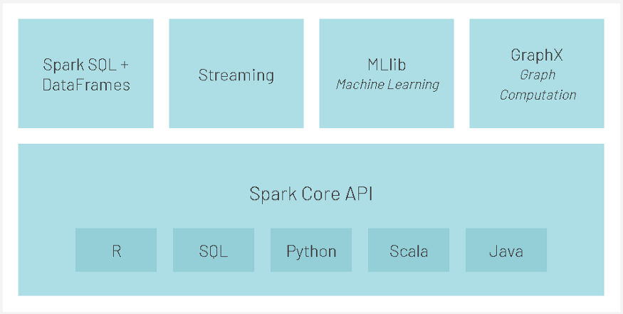
Components of spark

Slide 21
Spark SQL and DataFrame
Spark SQL is a Spark module for structured data processing. It provides a programming abstraction called DataFrame and can also act as distributed SQL query engine.
Spark SQL can be integrated with a variety of data sources including Hive, Avro, Parquet, JSON, and JDBC.

Slide 22
Spark Streaming
Spark Streaming — Spark streaming leverages the Spark Core API to perform real-time interactive data analytics while leveraging Spark’s fault tolerance semantics out of the box.
Spark streaming can be integrated with a wide variety of popular data sources like HDFS, Flume, Kafka, and Twitter.

Slide 23
GraphX
GraphX — GraphX is Spark API for building graphs and executing graph-parallel computation.
GraphX enables users to interactively build, transform graph-structured data at scale.

Slide 24
Spark MLLib
Spark MLib — MLib is a scalable machine learning library built on top of Spark Core API that delivers high-quality algorithms.
MLib can be used with any Hadoop data like HDFS, HBase, or local storage, making it easy to plug into Hadoop workflows.
The library is usable in Java, Scala, and Python as part of Spark applications.

Slide 25
Advantages of PySpark
Python is very easy to learn and implement and provides a simple and comprehensive API.
PySpark Provides an interactive shell to analyze the data in a distributed environment.
With Python, the readability of code, maintenance, and familiarity is far better.
It features various options for data visualization, which is difficult using Scala or Java.

Slide 26
Python + Spark = PySpark
Python is one of the most widely used programming languages, especially for data science and it is easier to learn compared to other programming languages.
Many practitioners are already familiar with Python Pandas data transformations and manipulations for extracting insights from the data.
With strong support from the open-source community, PySpark was developed using the Py4j library.

Slide 27
04
PYSPARK
Installing pyspark
Pyspark session

Slide 28
Installing pyspark
pip install pyspark

Slide 29
What is SparkSession?
SparkSession is an entry point to underlying PySpark functionality to programmatically create PySpark RDD, DataFrame, and Dataset.
SparkSession serves as a key to PySpark, and creating a SparkSession case is the first statement you can write to code with RDD, DataFrame. SparkSession will be generated using SparkSession.builder patterns.
Notes:
After Spark 2.0, SparkSession was used as a portal into PySpark to work with RDD and DataFrame. SparkContext served as an entry point before version 2.0. Spark 2.0 introduced the SparkSession class, which is a centralised class that contains all of the contexts that existed before the 2.0 update (SQLContext and Hive Context etc.).

Slide 30
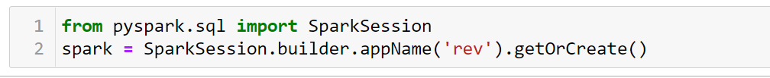
SparkSession

Slide 31

Code Demonstration

Slide 32
05
CONCLUSION
Group Activity
Summary

Slide 33

Activity : Exploring databricks
Scenario
Objective: Creating clusters using databricks
Steps:
Signup for databricks community account.
Create a cluster on databricks
Register a dataset on databricks
Write SQL Query on databricks notebook to load data.
How to create a cluster on databricks?
How to load data in spark

Slide 34
Quiz
Question - Which of the following is part of spark ecosystem?
GraphX
MLLiB
Spark Dataframes
All of above

Slide 35
Quiz
Question - Which of the following is part of spark ecosystem?
GraphX
MLLiB
Spark Dataframes
All of above
Answer: D

Slide 36
Quiz
Question - Spark is faster than Hadoop.
True
False

Slide 37
Quiz
Question - Spark is faster than Hadoop.
True
False
Answer - A

Slide 38
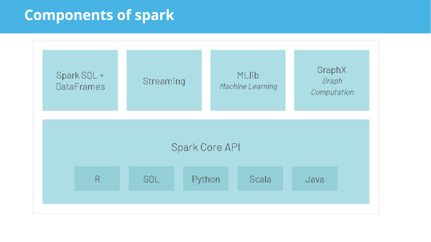
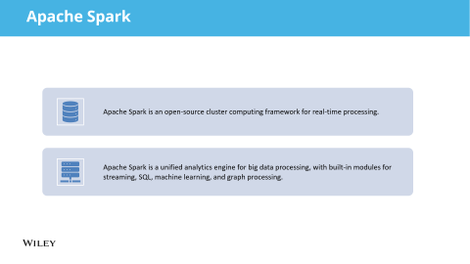
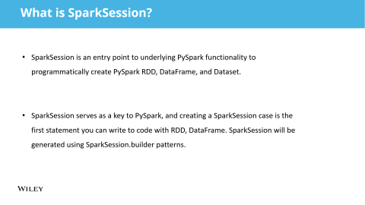
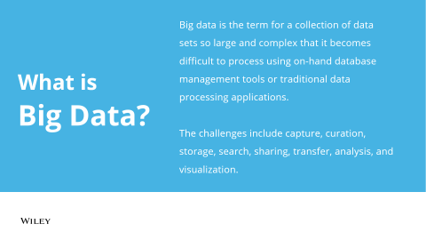
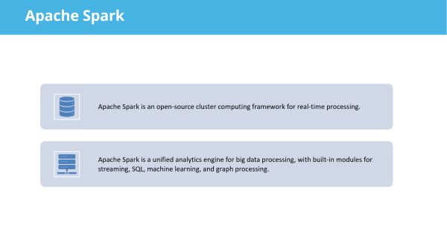
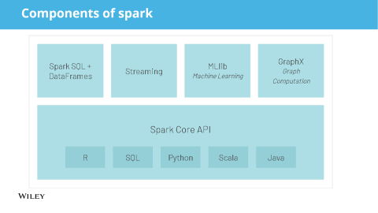

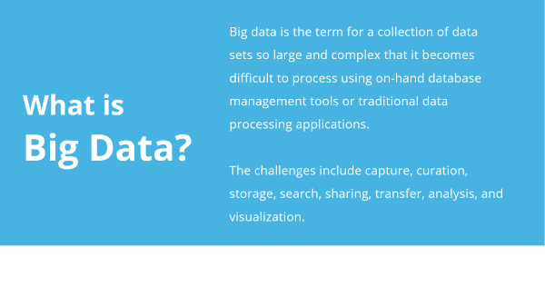
SUMMARY
Notes:
Big Data analytics is widely used across enterprises to drive business decisions and operations.
Spark is a faster big data analytics framework designed for realtime data and real time analytics
Spark Dataframes, GraphX, Spark streaming, Spark MLLib are components of spark ecosystem.
Sparl session is an entry point to starting with spark.

Slide 39

Questions?

